Slide 1
Custom PowerShell object formatting

Slide 2
About the speaker
Working at Microsoft for ~20 years (All with the Exchange Product 5.5 - 2019)
FastTrack Sr. Escalation Engineer (M365)
Previous Tools: OABInteg for Offline Address Lists
PowerShell Gallery Module: PSServicePrincipal
Contributor to: PSFramework
Github: https://GitHub.com/dgoldman-msft
Twitter: @matrixsurfer128
LinkedIn: https://www.linkedin.com/in/dgoldman-msft/
Project Files on GitHub

Slide 3
Presentation topics
PowerShell objects – Brief overview with regards to object formatting
The PowerShell Pipeline - how objects pass through the pipeline and formatting engine
The formatting criteria selection process
Extending and formatting objects in interactive PowerShell sessions and modules
Debugging PowerShell core – for those that are interested ☺
8 Demos!!

Slide 4
Powershell objects
Objects in its simplest form are containers that hold items.
Each Object originates from a .NET base Object. All actions take place within the context of that object.
Each Object contains the following object items:
1. Types - that define the object such as a Collection[], [String] and [Int].
2. Event –raise a notification about state changes based on conditions such as Network Related, Completion. Status, system conditions
3. Methods – allow you to preform actions on that object instance.
4. Properties – are structured collections that stores relevant object information such as a Number or a String value, etc.
Get-Member can be used to dump out objects to view them

Slide 5
Properties used for formatting objects
PSTypeNames – Defines the object type. The type links a view
PSStandardMembers – Is a MemberSet. Within this we can define the DefaultDisplayPropertertySet which is a set of properties that should be displayed if there isn’t a view defined.

Slide 6
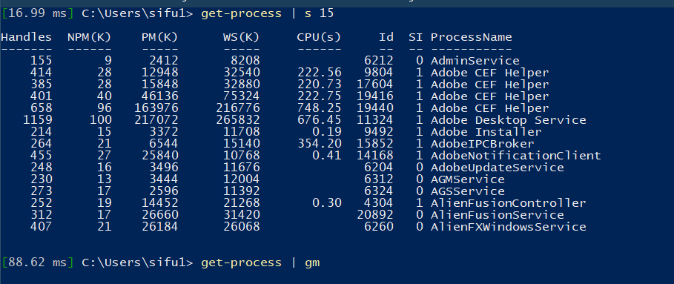
The PowerShell pipeline
PS> Get-Process | Where-Object {$_. Handles –gt 50} | Sort-Object Name, Handles | Format-Table
PowerShell Parser
Get-Process
Where-Object
Sort-Object
Out-Default & Out-Host
PowerShell Pipeline Processor
Notes:
You pass a command into the pipeline (Get-Process). A System.Diagnostics.Process object is created
This object will pass down the pipeline until it gets to the end of the pipeline. When an object reached the end of the pipeline PowerShell adds Out-Default to the pipeline (in the background).
Out-Default will hand off the object to Out-Host.
Out-Host will interact with the PowerShell formatting engine.
PowerShell formatting system will look up and resolve the object type to see if there is a predefined view associated with that object type. (This is stored in the type table cache)
IF NOT then the PowerShell formatting system will look to see if there is a user defined view with-in the types.ps1xml and format.ps1xml file (depending on being used within a module or a PowerShell session)
IF NOT the formatter will check the object next to see if the DefaultDisplayPropertySet is present. If there is no DefaultDisplayPropertySet
NOTE: For any object in PowerShell, you can access its PSStandardMembers.DefaultDisplayPropertySet property to see the properties that are default for that object, if they are defined.
IF NOT the PowerShell formatting system will do its best to create a format for the output in a table (default option) or list if there are too many properties to display (over 5 everything goes to a list).

Slide 7
Extending and formatting objects
TYPES.ps1xml – Extend object types.
Properties
Methods
Scriptblocks
…
FORMAT.ps1xml – Define how the objects view will be displayed.
Table
List
Wide
Custom
Notes:
MAML is an XML format used for PowerShell Online help
Microsoft Assistance Markup Language - MAML - https://en.wikipedia.org/wiki/Microsoft_Assistance_Markup_Language
ELABORATE on this one a little. Types.ps1xml - This file allows you to extend objects with additional properties (aliases, etc.)
Format.ps1xml - You have four different views of each object: Table, List, Wide, Custom.
The formatting affects only the display output. It doesn't affect which object properties are passed down the pipeline or how they're passed.
WARNING: You never want to update these core files because they are signed and can cause damage. What we can do is use one as a template for our custom object.
NOTE: Beginning with PowerShell 6, this information is compiled into PowerShell and is no longer shipped in a Types.ps1xml file.
DEMO: Files location: Stored in the following location: Get-ChildItem $PSHome/*type*.ps1xml

Slide 8
How to extend objects
Add-Member
Update-TypeData
Update-FormatData

Slide 9
Debug breakpoints for powershell core
PowerShell GitHub code: https://github.com/PowerShell/PowerShell
FormatViewManager.cs:
Lines 108, 117, 136, 416, 432
BaseCommand.cs:
Line 178
MshObjectUtil.cs:
Line 389
Also do a project search for:
DefaultDisplayPropertySet

Slide 10

DEMOS

